Slide 1
Financial Reporting & Analysis
Aurobindo Pharma Limited
Horizontal • Vertical • Trend • Ratio • DuPont Analysis
Sai Sanjeev Pilli | 2026010296
MBA Term-I | GITAM School of Business

Slide 2
1. Overview
Aurobindo Pharma Limited is an integrated global pharmaceutical company headquartered in Hyderabad, India.
Industry: Pharmaceutical
Founded: 1986
Headquarters: Hyderabad, Telangana, India
Business: Development, manufacturing and commercialization of generic pharmaceuticals, specialty products, APIs and other pharmaceutical products
Global Presence: Products and operations across 150+ countries/markets
Key Therapeutic Areas: CNS, cardiovascular, anti-retroviral, anti-diabetic, and other segments
R&D Focus: Strong in-house R&D capabilities supporting product development and regulatory filings

Slide 3
2. Objective and Scope
• Study the financial performance of Aurobindo Pharma Ltd.
• Period covered: FY2015 to FY2026.
• Use financial statements to understand growth, profitability, liquidity, solvency and efficiency.
• Apply five techniques: Horizontal, Vertical, Trend, Ratio and DuPont Analysis.

Slide 4
3. Horizontal Analysis – Income Statement
Compares financial figures over time.

Slide 5
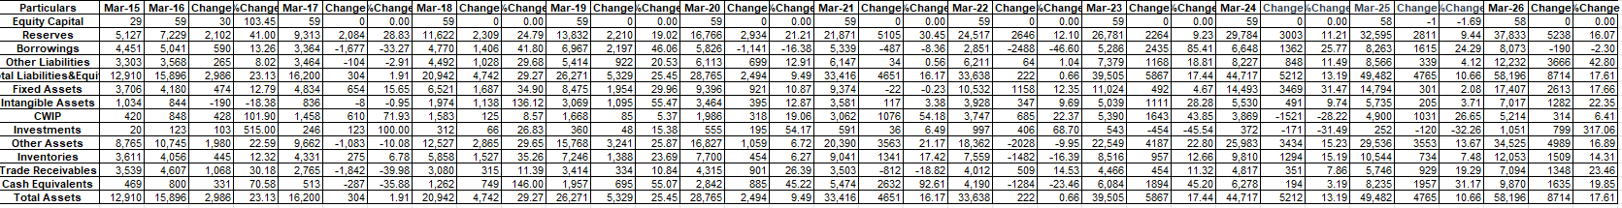
3. Horizontal Analysis – Balance Sheet
Compares financial figures over time.

Slide 6
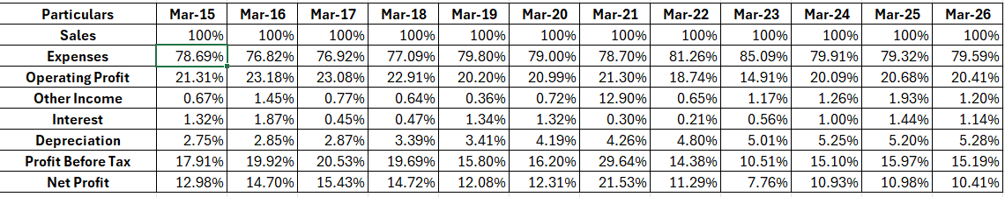
4. Vertical Analysis – Income Statement
Shows each item as a percentage of a common base.

Slide 7
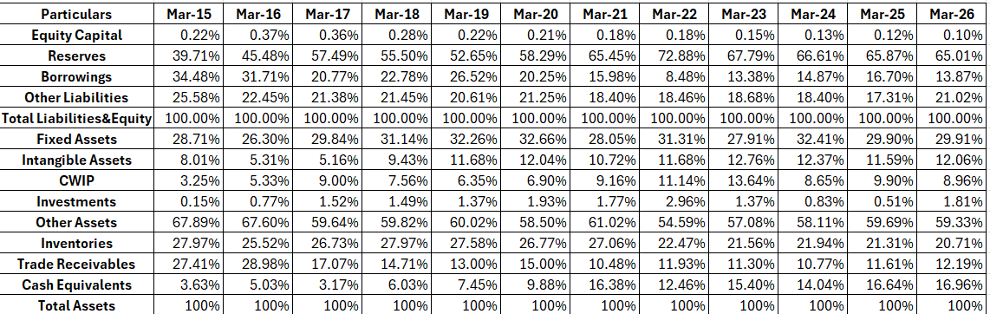
4. Vertical Analysis – Balance Sheet
Shows each item as a percentage of a common base.

Slide 8
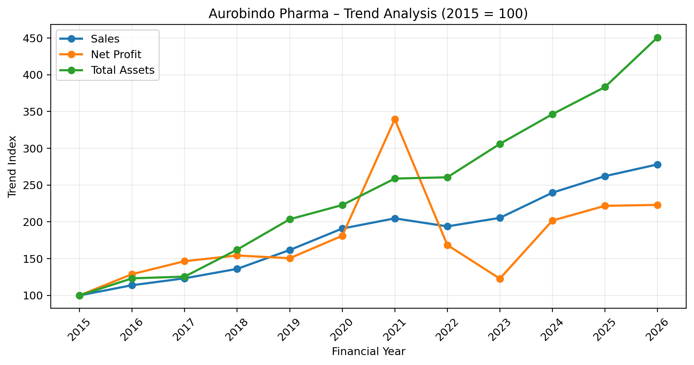
5. Trend Analysis
FY2015 is taken as the base year = 100.
Particulars | FY2015 | FY2026
Sales | 100 | 278.06
Operating Profit | 100 | 266.38
Net Profit | 100 | 222.98
Total Assets | 100 | 450.78
Reserves | 100 | 737.92
Borrowings | 100 | 181.37
• Sales almost tripled from the base year.
• Assets increased much faster than sales.
• Reserves showed the largest increase.
• Borrowings increased, but much less than reserves.

Slide 9
6. Ratio Analysis – Liquidity
Ratio | FY2015 | FY2026
Current Ratio | 2.65 | 2.82
Quick Ratio | 1.56 | 1.84
• Liquidity ratios stayed above 1.
• This indicates current assets were higher than current liabilities.

Slide 10
6. Ratio Analysis – Solvency
Ratio | FY2015 | FY2026
Debt-Equity | 0.86 | 0.21
Debt-to-Assets | 34.48% | 13.87%
• Relative leverage declined over the period.
• Borrowings formed a smaller share of assets.

Slide 11
7. Ratio Analysis – Profitability
Ratio | Earlier level | FY2026
Operating Profit Margin | 21.31% | 20.41%
Net Profit Margin | 12.98% | 10.41%
ROE | 32.53% | 9.93%
ROA | 14.05% | 6.51%
• Operating margin recovered after the FY2023 decline.
• Net margin in FY2026 was 10.41%.
• ROE and ROA were lower in the later years.
• FY2021 was unusually high and should be viewed separately.

Slide 12
8. Ratio Analysis – Turnover & Earnings
Measure | Earlier level | FY2026
Asset Turnover | 0.96 | 0.63
Receivables Turnover | 3.38 | 5.24
EPS | ₹26.98 | ₹60.34
• Asset turnover declined, meaning assets generated less sales per unit.
• Receivables turnover remained above the beginning level.
• EPS increased over the full period.

Slide 13
9. DuPont Analysis
DuPont explains ROE using three factors:
ROE = Net Profit Margin × Asset Turnover × Equity Multiplier
Year | Net Profit Margin | Asset Turnover | Equity Multiplier | ROE
FY2024 | 10.93% | 0.69 | 1.49 | 11.18%
FY2025 | 10.98% | 0.67 | 1.51 | 11.15%
FY2026 | 10.41% | 0.63 | 1.53 | 9.93%

Slide 14
10. Key Findings
• Sales and profits increased over the long term.
• The company expanded its asset base significantly.
• Liquidity remained comfortable.
• Relative leverage decreased.
• Profitability fluctuated, especially around FY2021 and FY2023.
• Asset turnover declined in the later years.
• EPS increased over the full study period.
• DuPont shows that FY2026 ROE was 9.93%, driven by margin, asset turnover and equity multiplier.

Slide 15
11. Conclusion
• Aurobindo Pharma showed strong long-term growth in sales, profits and assets.
• The financial position remained supported by good liquidity and lower relative leverage.
• The main area to monitor is the relationship between the growing asset base and the returns generated from it.
• The analysis is based on historical financial information for FY2015–FY2026.

Slide 16
Thank You
Aurobindo Pharma Limited – Financial Reporting & Analysis
Sai Sanjeev Pilli | 2026010296

